Slide 1


AI-BASED MULTI DISEASE DETECTION USING MACHINE LEARNING AND CONVOLUTIONAL NEURAL NETWORK
Presented by: Under the guidance of
Gorla Sukanya - 321114110021 Dr. K. Soumya
Jakkula Madhurima - 321114110022 Assistant Professor
Jeeri Alekhya Reddy - 321114110023 Department of
Kallakuri Vyshnavi - 321114110024 Computer Science and Engineering

Slide 2
Table of Contents
Abstract
Problem Statement
Introduction
Review of Literature
Methodology
Project Flow
Hardware Requirements
Software Requirements
UML Diagrams
Outputs
Results and Analysis
Conclusion and Future Scope
References

Slide 3
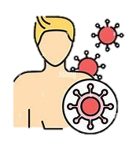
ABSTRACT
AI-Based Multiple-Disease Detection uses Artificial Intelligence to diagnose diseases with high accuracy using minimal inputs.
This system integrates Convolutional Neural Networks (CNN) for medical image feature extraction, enhancing both efficiency and precision.
Trained on diverse datasets, including images, patient records, and time-series data, it can detect a wide range of diseases such as Cancer, Heart Disease, Kidney Disease, and Parkinson’s.
The hybrid neural network approach ensures robust feature learning, pattern recognition, and optimization, making it highly suitable for real-world clinical applications.
Experimental results demonstrate low false positives, improved accuracy, and strong generalization across different datasets. AI-driven models like this play a crucial role in early disease detection, medical assistance, and improving patient outcomes, offering significant benefits in the expanding medical field.

Slide 4
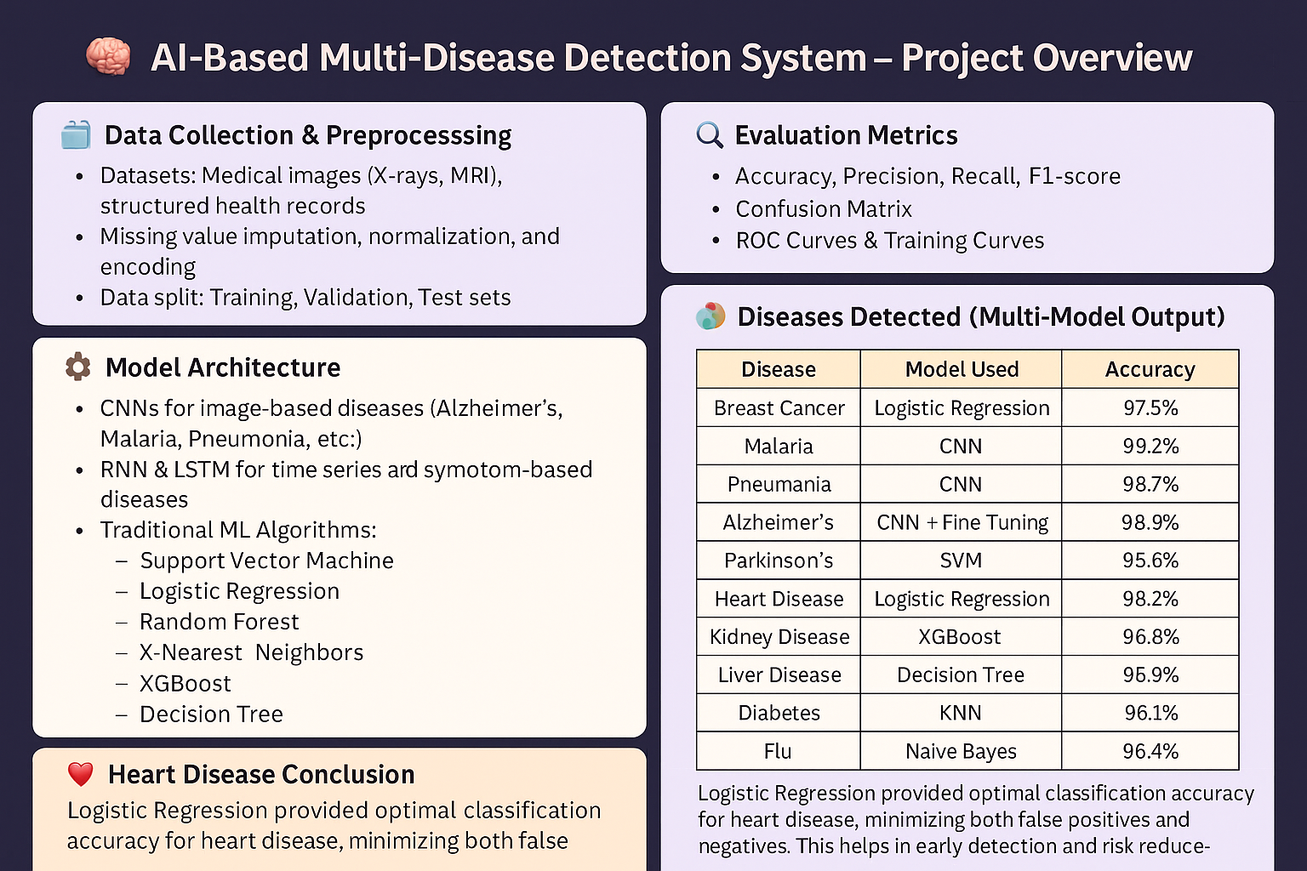
AI-BASED MULTIPLE-DISEASE DETECTION SYSTEM – AN OVERVIEW
PROBLEM STATEMENT:
Patients often suffer due to late or inaccurate diagnosis. What if AI could help detect diseases early using just input parameters or medical scans?
Disease Detection models:
Disease detection models show consistent and accurate performance across multiple conditions. Overall, the models contribute to enhanced healthcare by supporting proactive diagnosis.
Model Architecture
CNNs for image-based diseases (Alzheimer’s, Malaria, Pneumonia, etc.)
RNN & LSTM for time series and symptom-based diseases
Traditional ML Algorithms:
Support Vector Machine
Logistic Regression
Random Forest
K-Nearest Neighbors
XGBoost
Decision Tree

Slide 5

PROBLEM STATEMENT
Despite the advancements in AI and machine learning for disease detection, most existing systems are limited to identifying a single disease and not be able to work with real time data.
This lack of versatility forces individuals to rely on multiple tools for different
conditions, leading to increased complexity and inefficiency in the diagnostic process.
Additionally, many AI-based diagnostic applications are not understandable by
non-medical personnel, making them difficult to access for individuals without technical expertise.
So, this project aims to address these challenges by developing an AI-based multi-disease detection system using Machine Learning with CNNs through a user-friendly web application.

Slide 6

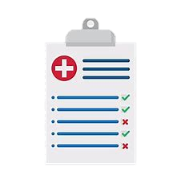
INTRODUCTION
The AI-Based Multi-Disease Detection System revolutionizes healthcare by enabling early and accurate diagnosis of multiple diseases, addressing the limitations of traditional, costly, and time-consuming diagnostic methods.
This user-friendly web application utilizes deep learning models - CNNs for image-based diseases like breast cancer, pneumonia, malaria and Alzheimer’s.
Unlike existing AI tools that focus on single diseases, this system provides a comprehensive solution, integrating advanced AI models into a streamlined platform, this project enhances efficiency, accuracy, and accessibility in medical diagnostics.
Despite the advancements in AI and machine learning for disease detection,
most existing systems are limited to identifying a single disease.

Slide 7
REVIEW OF LITERATURE
Litjens, et al., [3] highlights the role of neural networks (CNNs) to detect subtle patterns in imaging data such as MRI, CT, and X-rays. This approach significantly improves diagnostic accuracy for conditions like cancer and neurological disorders, often surpassing traditional methods.
Jinyuan Gong (2025) [6] investigates the clinical value of combined blood lipid, glucose, and liver function tests in 105 NAFLD patients from May 2022 to July 2024, categorized by severity (mild, moderate, severe) and compared to 30 healthy controls. Results show elevated triglycerides, cholesterol, LDL, glucose, and liver enzymes (TBil, AST, ALT) in NAFLD groups, with worsening levels correlating to disease severity, while HDL decreases.
Huimin Lu et al., [8] introduces a novel handwriting-based method to detect Parkinson’s disease (PD) by extracting dynamic features like kinematics, pressure, and angles. It proposes a new "moment feature" integrating these aspects and uses time-frequency-based statistical (TF-ST) features for a comprehensive analysis.
Shickel, B., et al., [1] states that Machine learning facilitates multi-disease prediction by integrating diverse patient data, including imaging, lab results, and clinical histories. It demonstrates the power of data-driven insights in improving healthcare outcomes.

Slide 8
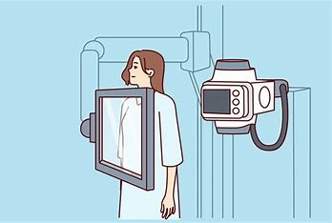
METHODOLOGY
1. Data Preprocessing: Cleaned and normalized medical datasets
(e.g., imaging, clinical records) for consistency.
2. Feature Extraction: Identified key disease markers using statistical
and domain-specific techniques.
3. Algorithms Used:
Support Vector Machine (SVM): Classified diseases based on optimal hyperplane
XGBoost: Boosted decision trees for high-accuracy predictions.
Additional Models: Explored Random Forest and CNNs for robustness.
Decision Trees: Modeled disease patterns with interpretable rules.
4. Training & Validation: Split data into 80-20 train-test sets; used cross-validation for performance tuning.
5. Evaluation: Measured accuracy, precision, and recall across multi-disease outputs.

Slide 9
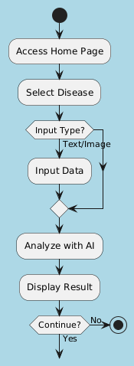
PROJECT FLOW

Slide 10
HARDWARE REQUIREMENTS
Processor: A multi-core CPU (e.g., Intel i5 or higher) is required, with at least 4 cores to support parallel processing during model training.
Memory: Minimum 8 GB RAM, with 16 GB recommended for efficient handling of large datasets and multitasking.
Storage: At least 256 GB SSD for faster read/write speeds, with 50 GB free space for software, datasets, and model files.
Graphics: An optional NVIDIA GPU for accelerating deep learning model training; CPU-only execution is viable but slower.
Display: Minimum resolution of 1366x768 for comfortable frontend development and testing.
Internet: Stable broadband connection (minimum 10 Mbps) for downloading datasets and dependencies.

Slide 11
SOFTWARE REQUIREMENTS
Development Environment: Visual Studio Code (VS Code) Version 1.88.0 serves as the primary IDE.
Notebook Interface: Jupyter Notebook environment for model development, training, and testing.
Operating System: Windows 11 Version 22H2 is the target OS, providing a stable and widely used platform for development.
Backend Framework: Flask Version 2.2.3 is used for integrating AI models with the web interface, handling HTTP requests.
Frontend Technologies: HTML5, CSS3, and JavaScript (ES6+) are employed to create a responsive and interactive user interface.
Datasets: Data sourced from Kaggle, including medical imaging datasets like chest X-rays or skin lesion images is used for training.
Additional Libraries: Python libraries such as TensorFlow Version 2.11.0, Keras Version 2.11.0, NumPy Version 1.24.2, Pandas Version 1.5.3, Scikit-learn Version 1.2.2, OpenCV Version 4.7.0, Matplotlib Version 3.7.1, Plotly Version 5.14.1 are dependencies, installed via pip.

Slide 12
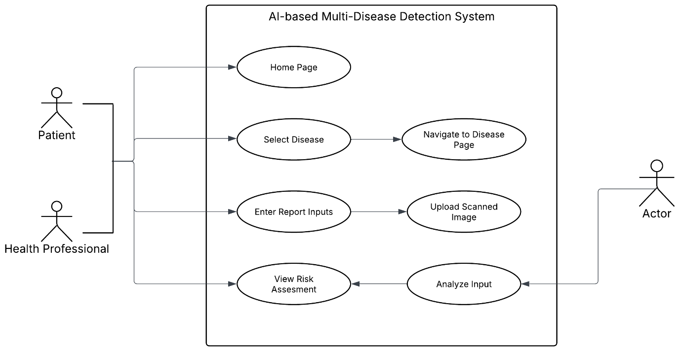
UML DIAGRAMS
Use Case Diagram
AI-System

Slide 13
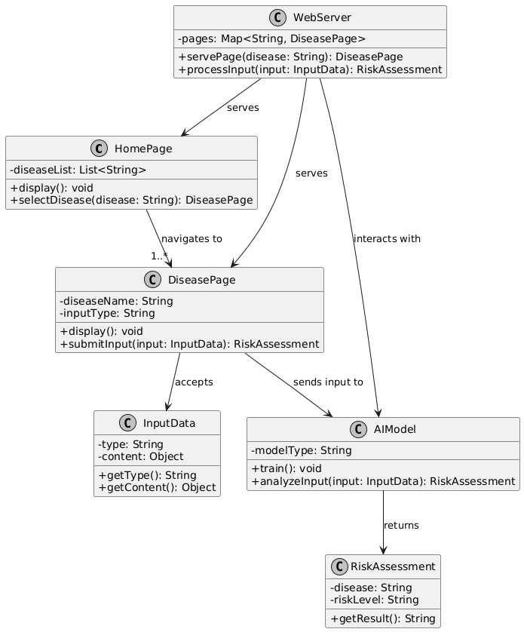
Class Diagram

Slide 14
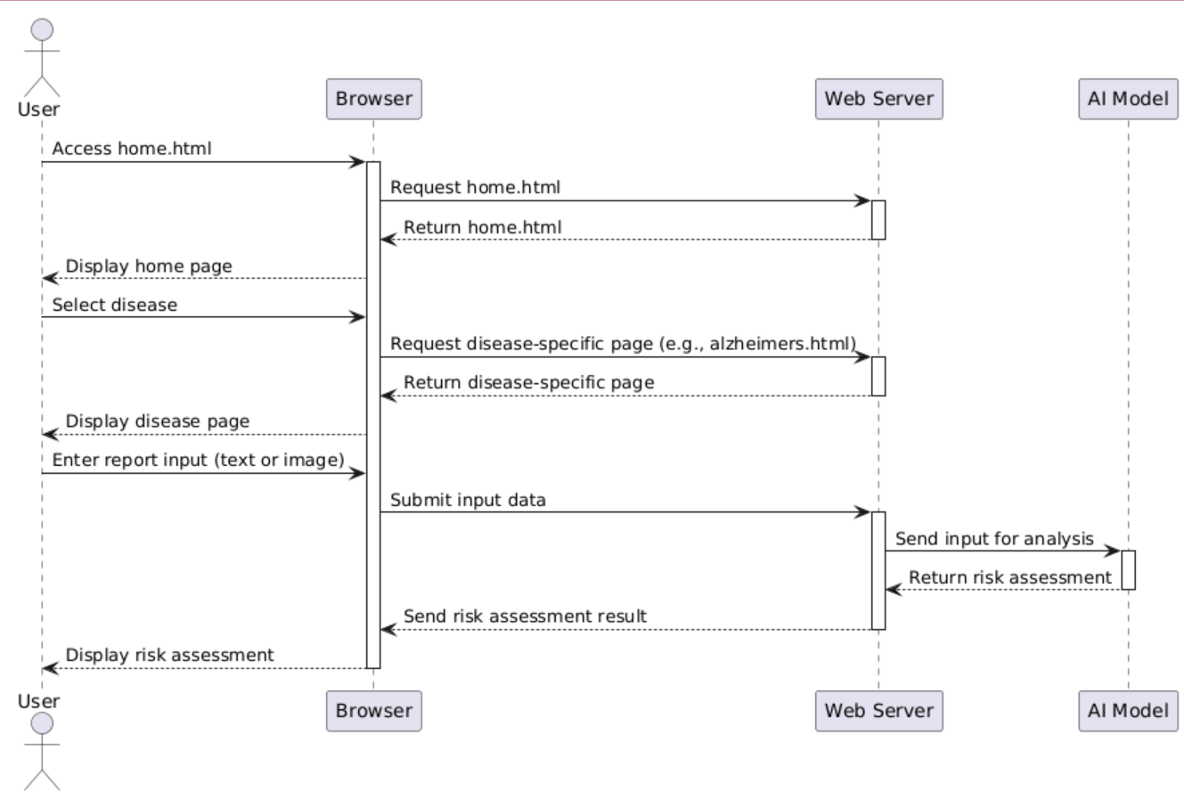
Sequence Diagram

Slide 15
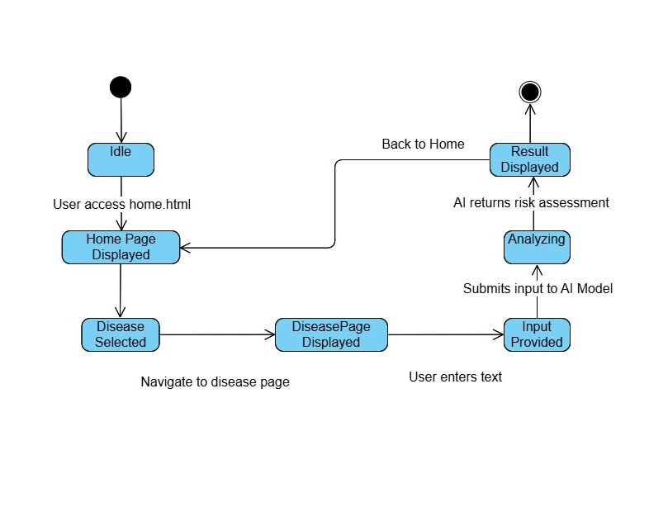
State Machine Diagram

Slide 16
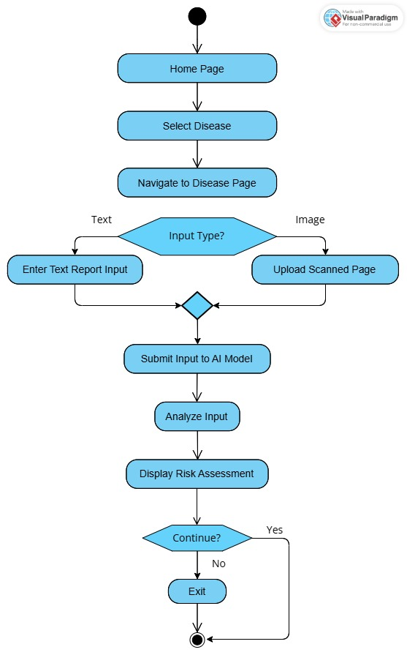
Activity Diagram

Slide 17
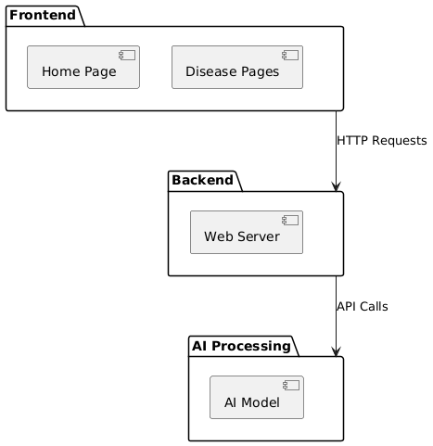
Package Diagram

Slide 18
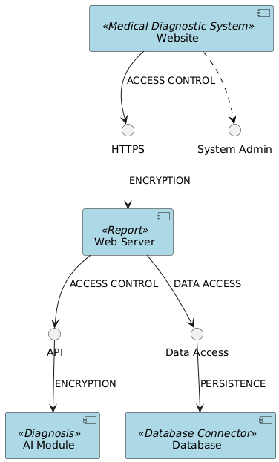
Component Diagram

Slide 19
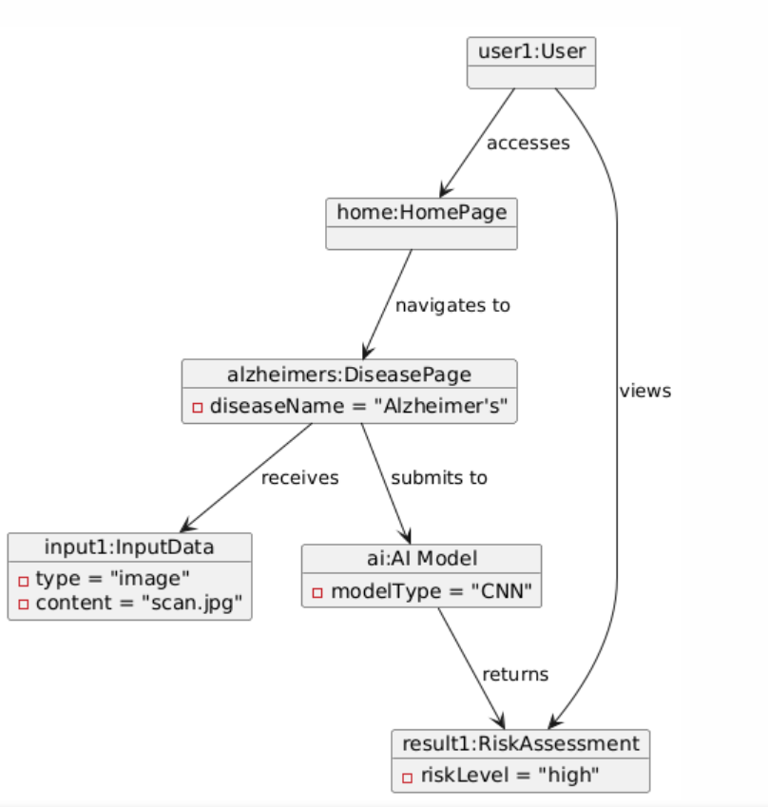
Object Diagram

Slide 20
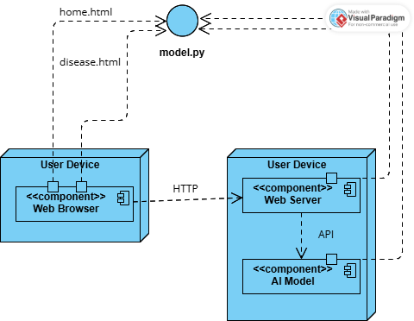
Deployment Diagram

Slide 21
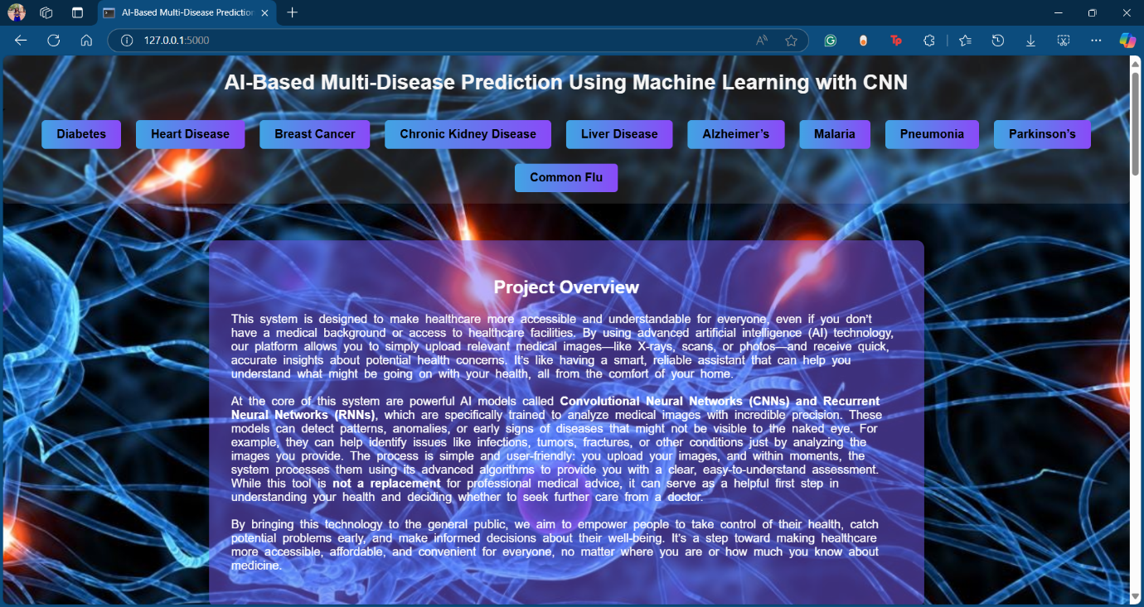
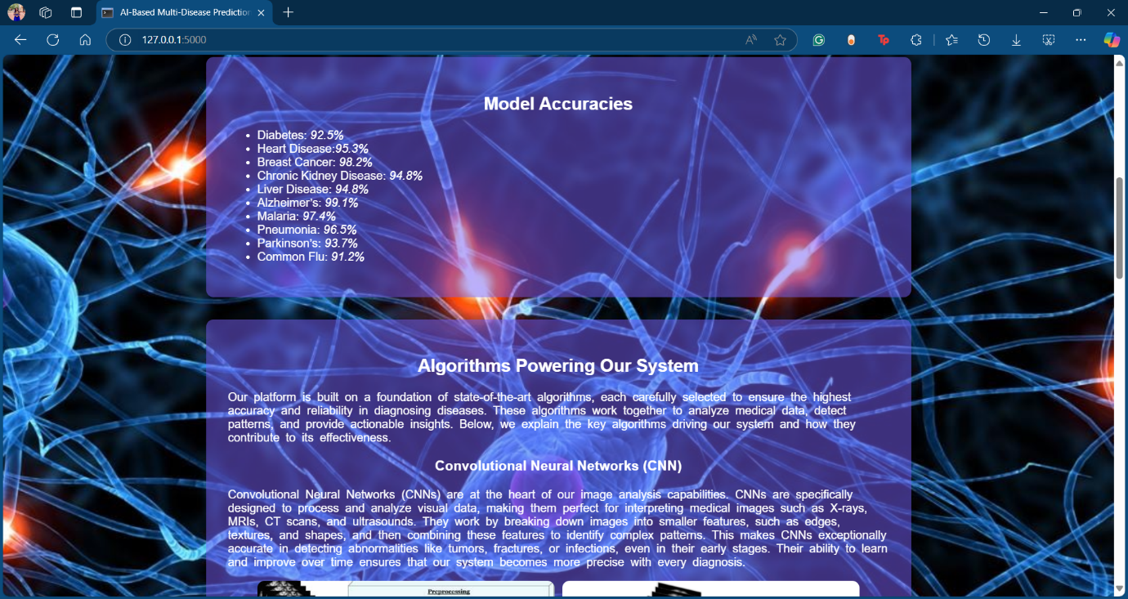
OUTPUTS

Slide 22
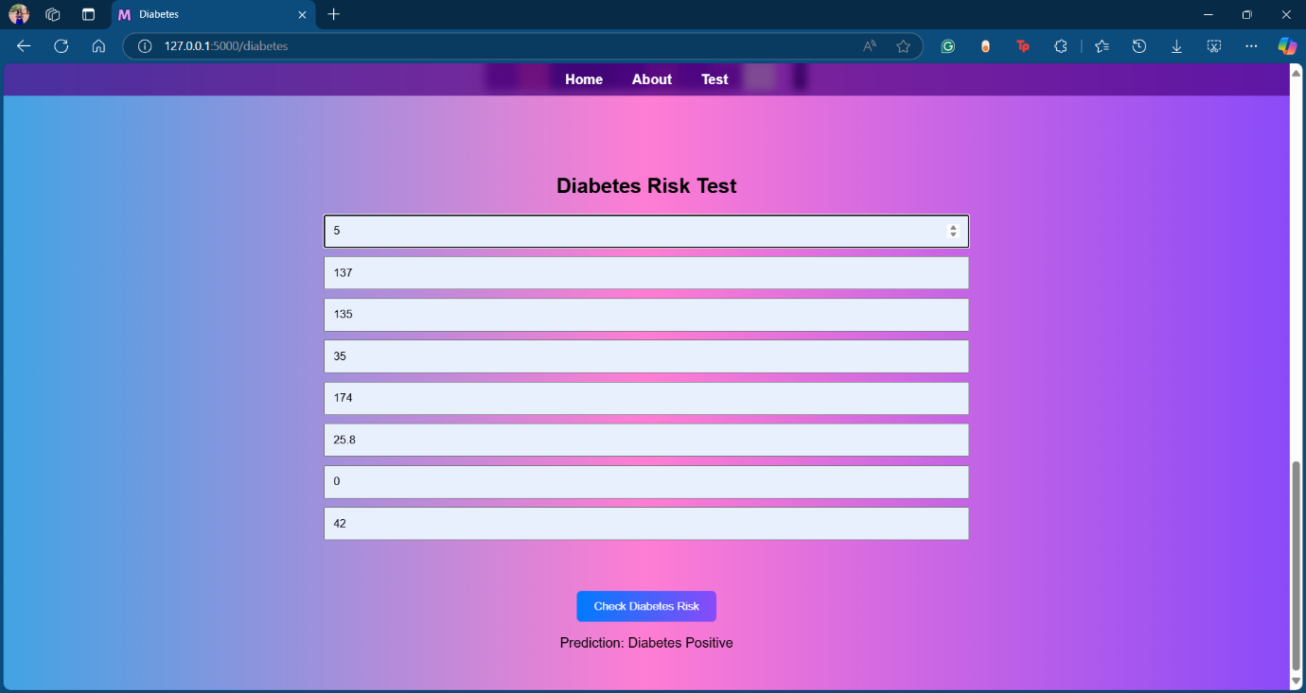
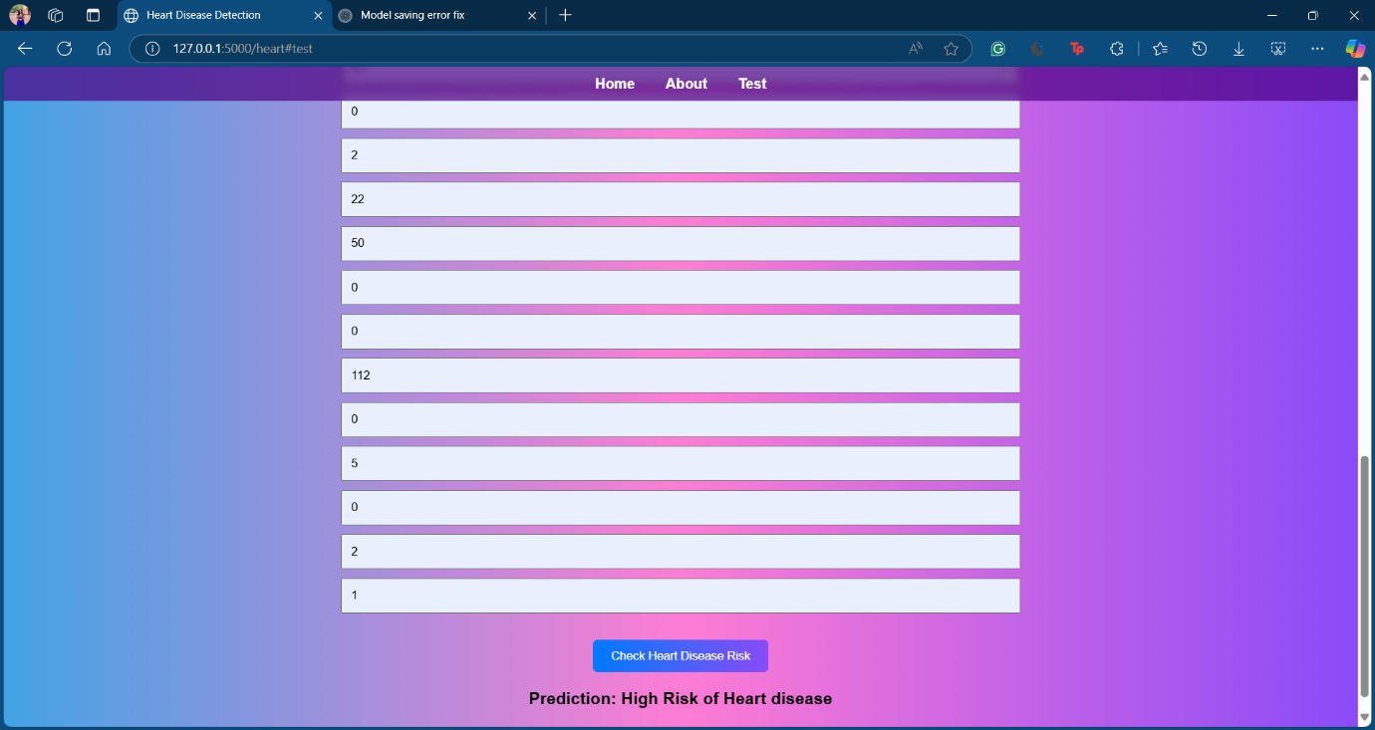
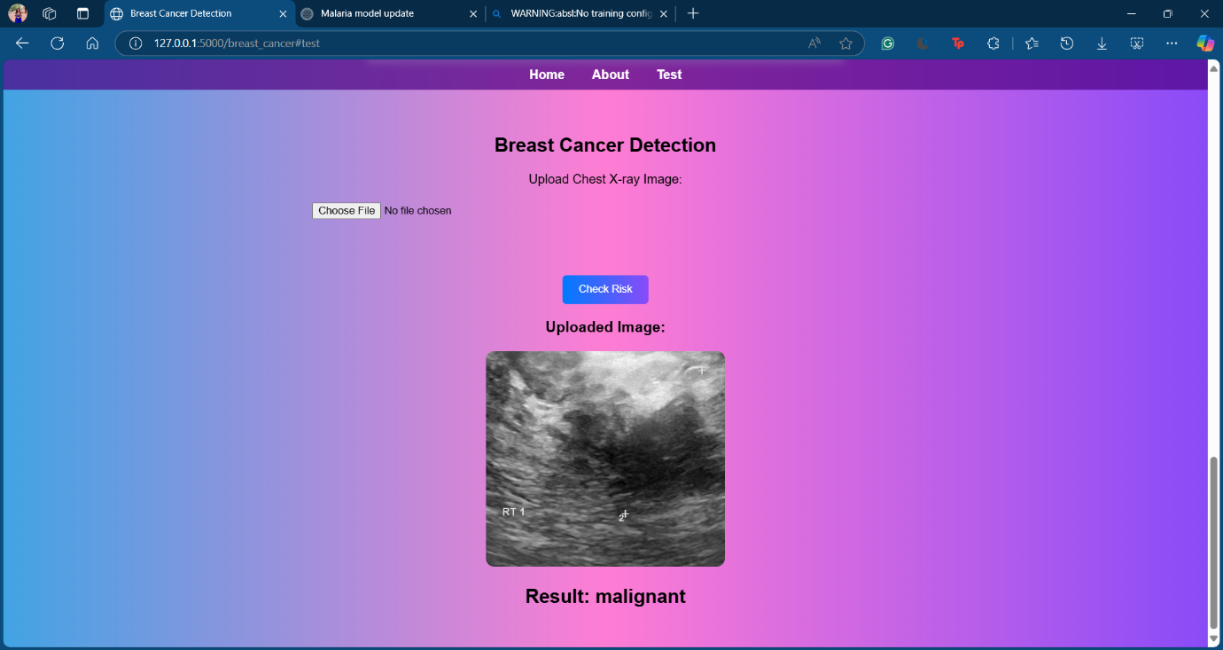
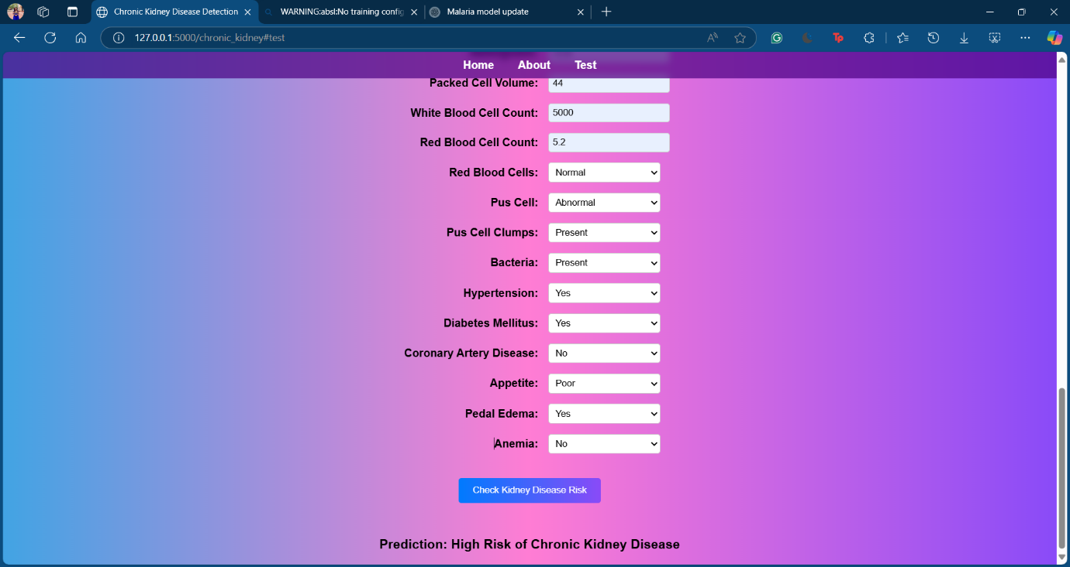

Slide 23
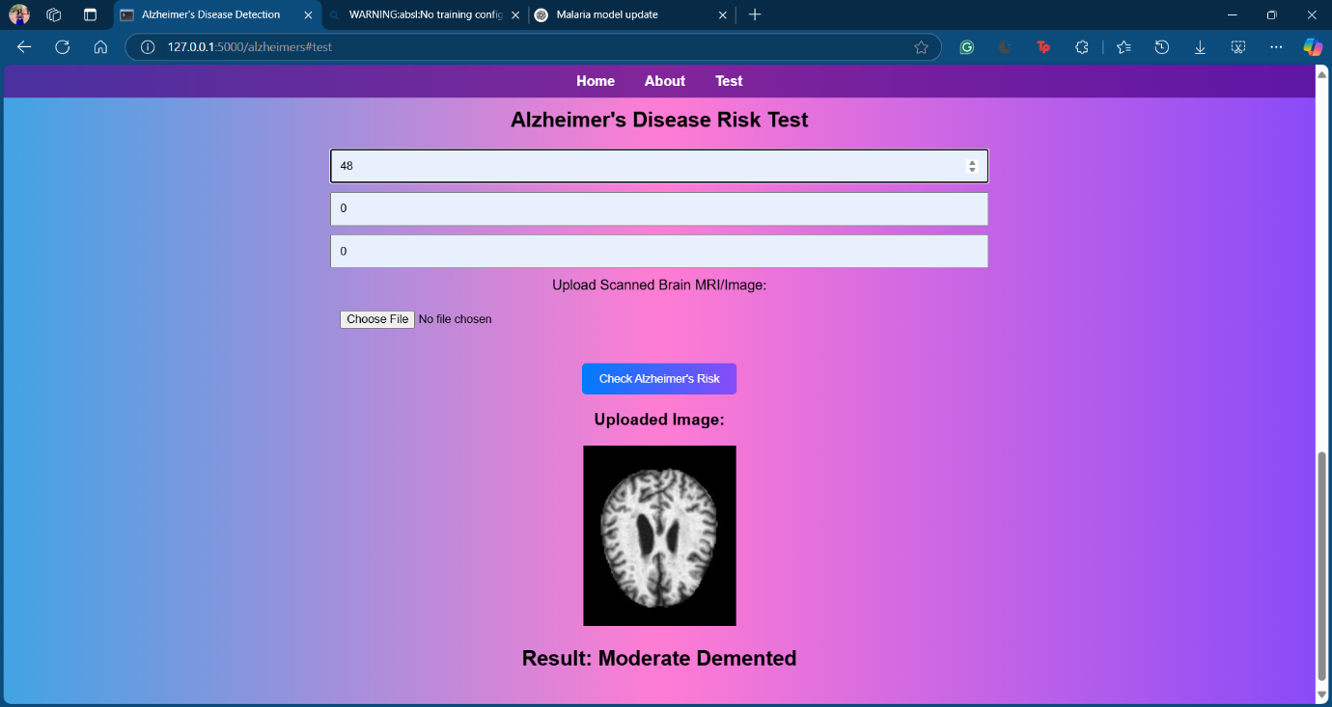
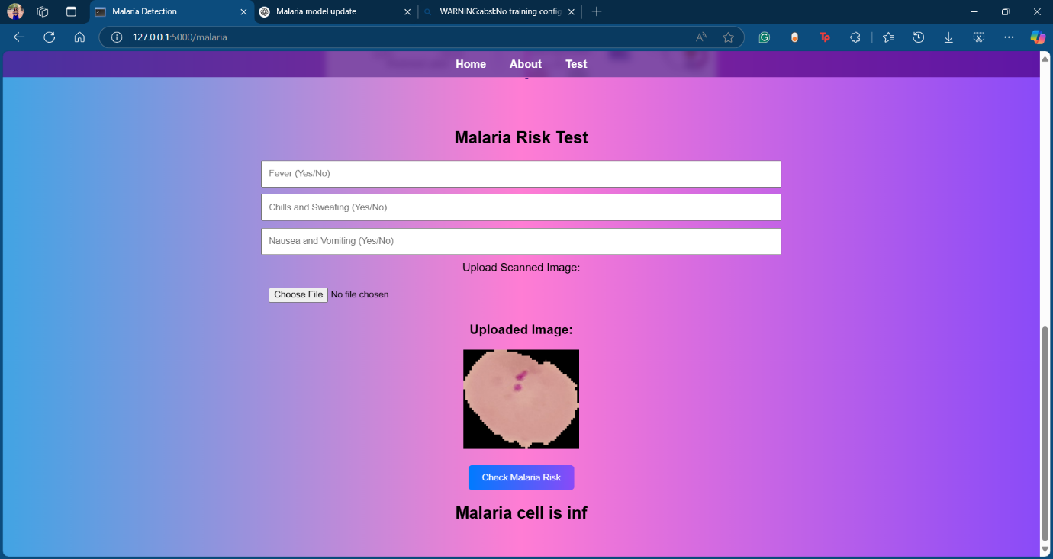
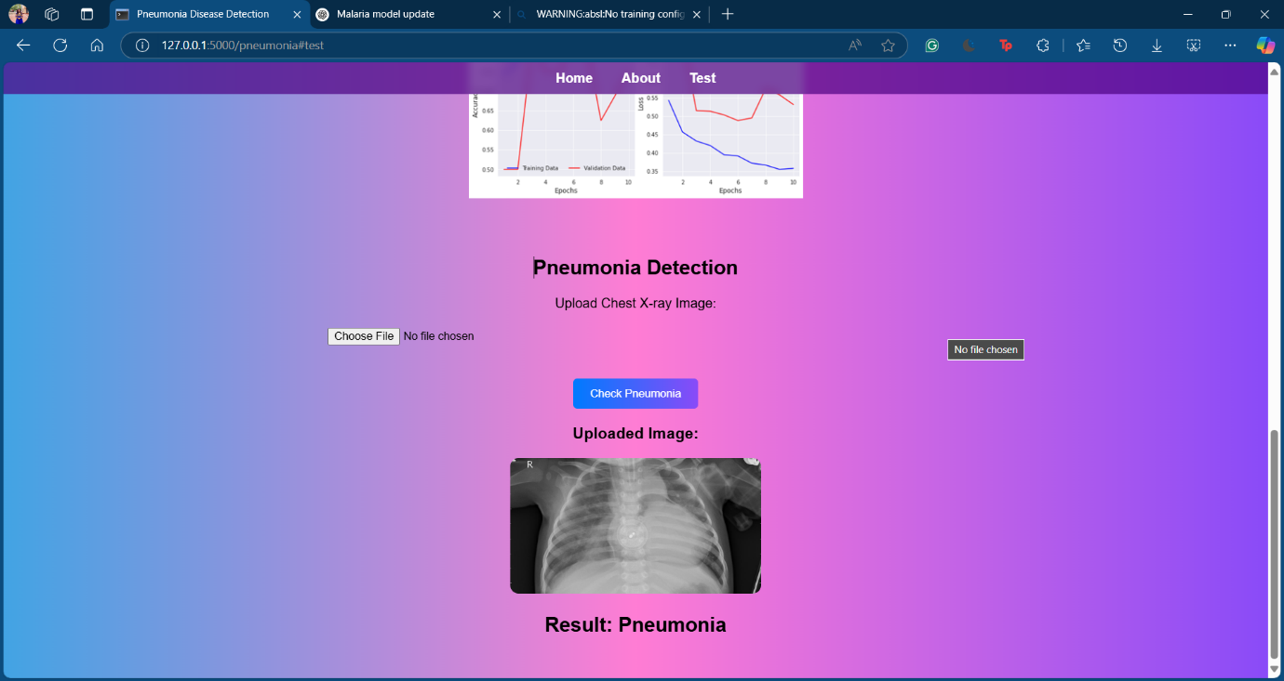
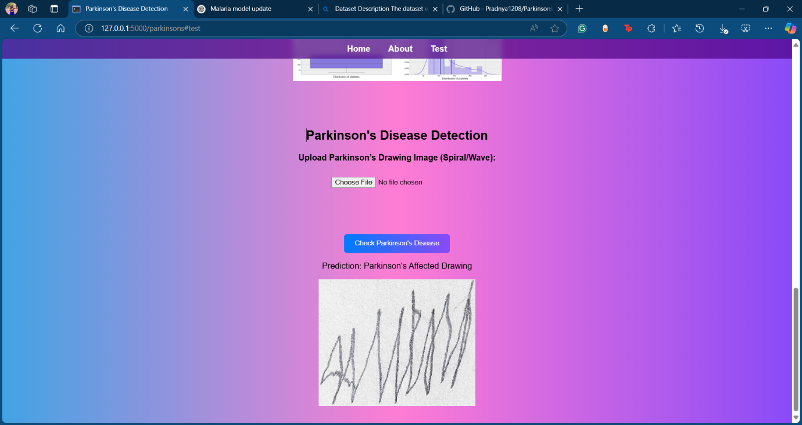

Slide 24
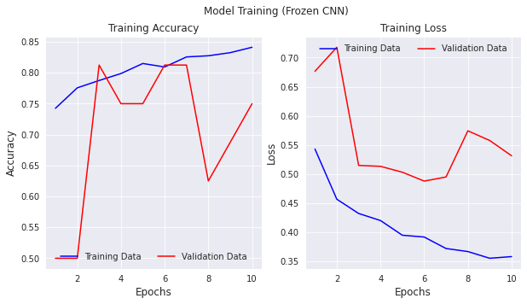
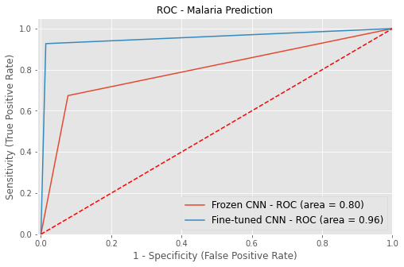
RESULTS AND ANALYSIS
The below two graphs show the training accuracy and loss for Pneumonia disease detection using CNN, which illustrates the model’s learning behaviour over epochs.
The ROC Curve for Malaria shown below is used to visualizing the comparison between the algorithms in terms of their performance and their ability to predict accurate output.

Slide 25
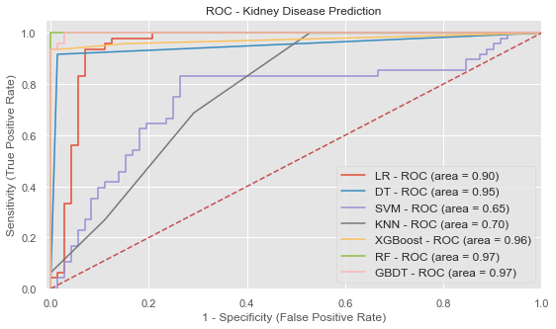
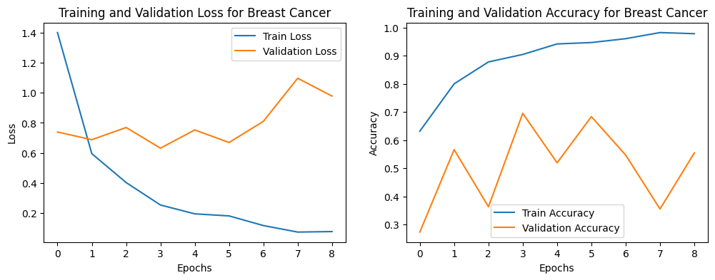
The above graphs depicts the training , validation loss and accuracy for breast cancer prediction during the training phase.
This visualization helps in assessing the model’s performance for the given dataset
The ROC curve shown above for Chronic kidney disease prediction n evaluates the performance of different machine learning models by plotting Sensitivity (True Positive Rate) against 1-Specificity (False Positive Rate).

Slide 26
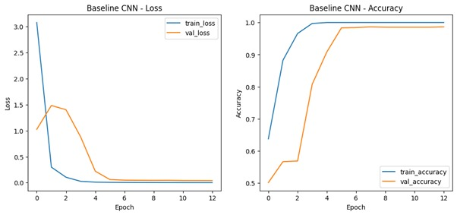
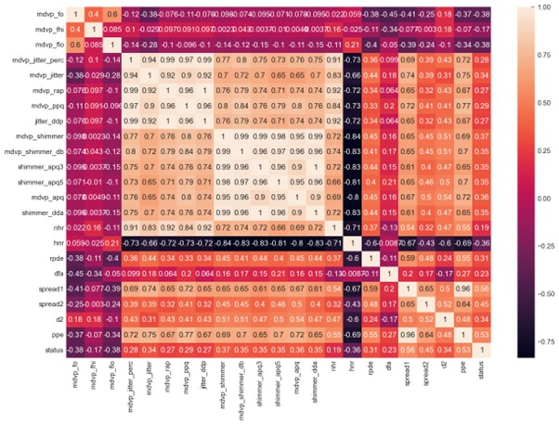
The above presents training and validation performance graphs for Alzheimer's disease detection using CNN models.
The loss graphs (left column) show how training and validation losses decrease over epochs, indicating model learning.
The accuracy graphs (right column) illustrate how the training and validation accuracy evolve over time.
The heatmap shows the correlation coefficients between different features in a Parkinson’s dataset. Correlation values range from -1 to 1.
A large cluster in the middle (light colors, values close to 1) shows features like mdvp_jitter, shimmer, spread, etc., are strongly correlated with each other.

Slide 27
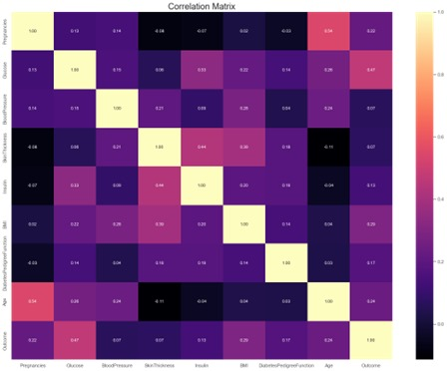
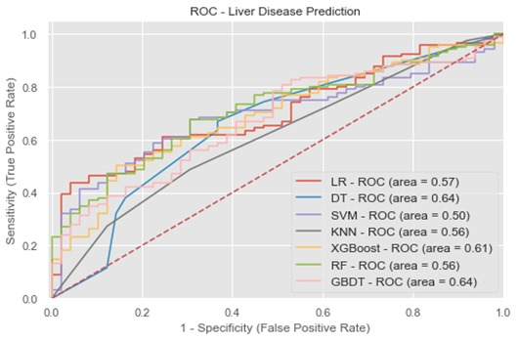
This heatmap shows the correlation matrix for features in a Diabetes dataset.
Notably, Glucose has the strongest positive correlation with Outcome, indicating its significance in predicting diabetes.
The ROC shows the correlation between the false positive and true positive rate for liver disease.

Slide 28
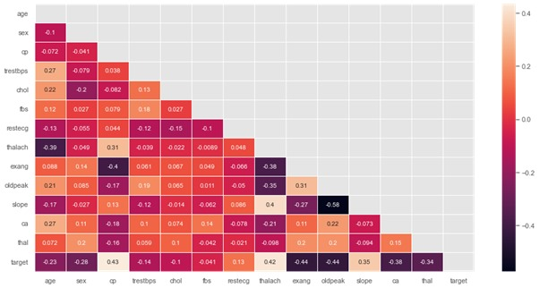
This correlation matrix for a Heart disease dataset, visualized as a lower triangle heatmap.
The target variable (presence of heart disease) is positively correlated with features like thalach (max heart rate) and slope, and negatively correlated with ca, thal, and oldpeak.

Slide 29
Diabetes Liver Disease
S.No | Model | Score
1 | Random Forest Classifier | 92.54%
2 | Decision Tree Classifier | 89.47%
3 | Gradient Boosting | 89.04%
4 | Logistic Regression | 88.16%
5 | XGBoost | 87.72%
6 | SVM | 84.21%
7 | KNN | 83.33%
S.No | Model | Score
1 | SVM | 0.917532
2 | Decision Tree Classifier | 0.977273
3 | Gradient Boosting | 0.977273
4 | XGBoost | 0.970779
5 | Logistic Regression | 0.883117
6 | KNN | 0.860390

Slide 30
Pneumonia Disease
Parkinson’s Disease
Model Type | Accuracy (%)
Frozen CNN | 80.13%
Fine-tuned CNN | 91.35%
S. No. | Model Name | Accuracy
1 | Random Forest | 94.87%
2 | XGBoost | 94.87%
3 | K-Nearest Neighbors (KNN) | 94.87%
4 | Decision Trees | 92.31%
5 | Logistic Regression | 89.74%
6 | Support Vector Classifier (SVC) | 87.18%
Malaria Disease
Model Type | Accuracy (%)
Frozen CNN | 78%
TransferLearning (ResNet50) | 96%
Common Flu
Model | Accuracy
JavaScript logic | 99.8%

Slide 31
Kidney Alzheimer’s
S.No | Model | Score
1 | Random Forest Classifier | 0.991667
2 | Gradient Boosting | 0.975000
3 | XGBoost | 0.966667
4 | Decision Tree Classifier | 0.941667
5 | Logistic Regression | 0.908333
6 | KNN | 0.700000
7 | SVM | 0.700000
Method | Training Accuracy | Validation Accuracy | Test Accuracy
Baseline CNN | 39.58% | 98.63% | 98.41%
Augmented CNN | 49.88% | 50.24% | 50.04%
Transfer Learning (ResNet50) | 50.00% | 49.95% | 50.04%

Slide 32
Breast Cancer
Method | Training Accuracy | Validation Accuracy | Test Accuracy
Baseline CNN | 93.47% | 98.63% | 99.1%
CNN with Data Augmentation | 80.21% | 92.56% | 82.04%
Transfer Learning (ResNet50) | 68.45% | 80% | 70.04%

Slide 33
OVERALL ACCURACY TABLE
Disease | Best Performing Model | Accuracy
Diabetes | Random Forest Classifier | 92.54%
Heart Disease | Random Forest Classifier | 99.16%
Liver Disease | Support Vector Machine (SVM) | 91.18%
Kidney Disease | Random Forest Classifier | 99.16%
Malaria | ResNet50 (Transfer Learning) | 96%
Pneumonia | Fine-tuned CNN | 91%
Parkinson’s | XGBoost Classifier | 98.31
Alzheimer’s | Baseline CNN | 98.41%
Breast Cancer | Logistic Regression | 98%
Common Flu | JavaScript Logic | 99%

Slide 34
CONCLUSION AND FUTURE SCOPE
The AI-Based Multi-Disease Detection System utilizes CNNs to provide a comprehensive diagnostic solution for multiple diseases, enhancing accuracy, efficiency, and accessibility in healthcare.
Unlike traditional single-disease detection methods, this system integrates diverse datasets and advanced deep learning techniques to ensure reliable results.
Its user-friendly web interface enables accessibility for both medical professionals and general users, including those in remote areas with limited healthcare facilities.
Future developments include a cross-platform mobile application for real-time diagnostics and offline capabilities, allowing users to receive health assessments without an internet connection, further expanding its reach to underdeveloped regions.

Slide 35
REFERENCES
Litjens, G., Kooi, T., Bejnordi, B. E., Setio, A. A. A., Ciompi, F., Ghafoorian, M., van Ginneken, B., & van der Laak, J. A. W. M. (2017). Deep learning for medical image analysis. Medical Image Analysis, 42, 60–88.
Shen, D., Wu, G., & Suk, H.-I. (2017). A survey on deep learning in medical image analysis. IEEE Transactions on Medical Imaging, 36(11), 2037–2052.
Nie, D., Trullo, R., Petitjean, C., Ruan, S., & Shen, D. (2017). Medical image synthesis with deep convolutional adversarial networks. IEEE Transactions on Medical Imaging, 36(12), 2533–2543.
Swaroop Sana. (2024). Multi Disease Prediction System Using Machine Learning, DOI: 10.56726/IRJMETS49550.
Alotaibi, A. (2025). Ensemble deep learning approaches in health care: A review. Computers, Materials & Continua.

Slide 36
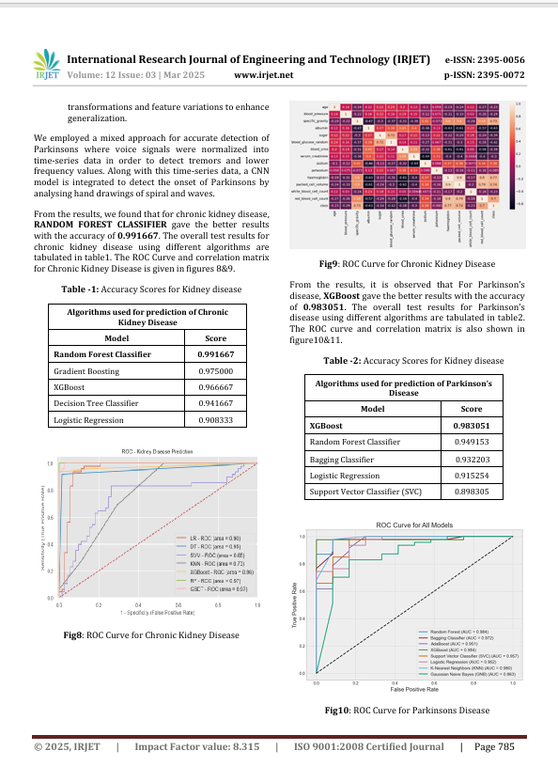
LIST OF PUBLICATIONS
JOURNAL NAME: International Research Journal of Engineering and Technology
LINK:
https://www.irjet.net/archives/V12/i3/IRJET-V12I3121.pdf

Slide 37
BIBLIOGRAPHY
Timothy C. Lethbridge & Robert Laganière, Object-Oriented Software Engineering: Practical Software Development using UML and Java, McGraw-Hill Education, 2004, ISBN: 9780077109113.
Ian Goodfellow, Yoshua Bengio, and Aaron Courville, Deep Learning, MIT Press, 2017, ISBN: 9780262035613.
Chris Albon, Machine Learning with Python Cookbook: Practical Solutions from Preprocessing to Deep Learning, O’Reilly Media, 2018, ISBN: 9781491989388.
Elaine Rich & Kevin Knight, Artificial Intelligence, Tata McGraw-Hill Publications, 3rd Edition, 2008, ISBN: 9780070087708.
Rafael C. Gonzalez & Richard E. Woods, Digital Image Processing, 4th Edition, Pearson/Addison-Wesley, 2018, ISBN: 9780133356724.

Slide 38
THANK YOU

